Slide 1

Mobile application
TEAM
Lee Jae Yoon Oh Seong Won
Lee Sung Min Lee Su Bin

Slide 2
CONTENTS
01
04
Title
Key features and advantages
02
05
Team members information
Implementation details
03
06
Introduction / brief description
Job assignment

Slide 3

01. Title
: How can we manage our time efficiently?

Slide 4




02. Team member
Lee Jae Yoon
2jyoons@
naver.com
Oh Seong Won
osw970325@
naver.com
Lee Sung Min
jm970326@
naver.com
Lee Su Bin
eoskan71@
gmail.com

Slide 5
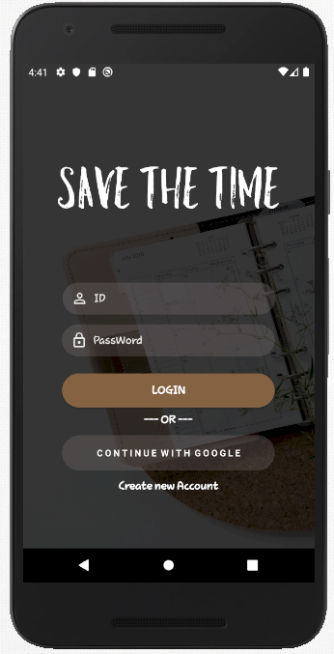
03. Key features and advantages
Introduction
: Save the time is the schedule management application
Brief description
: It recommend not only the ability to share schedules among people, but also the time they can use in common

Slide 6
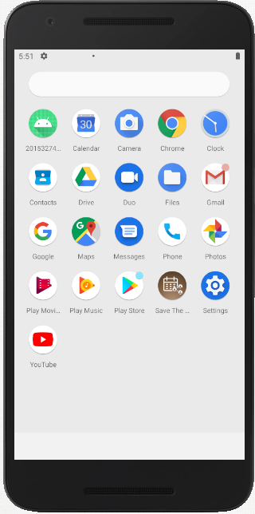

04. Key features and advantages
Key features and advantages
Group management :: recommend function
Login with google :: easy to login
Convenient UI
Efficient schedule management(Individual, group)

Slide 7
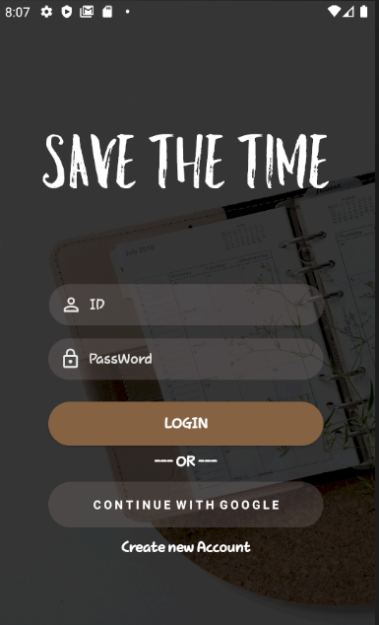
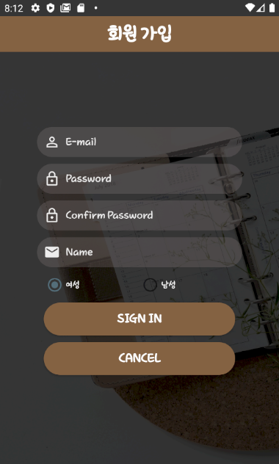
05. Implementation details
Login through google account
If user have a Google account, user can create an account without the need to sign up.
The created account is saved as firebase.
Create new account
If the user does not have a Google account, he/she can create and
use an account through the
application's own membership function.
01
02

Slide 8
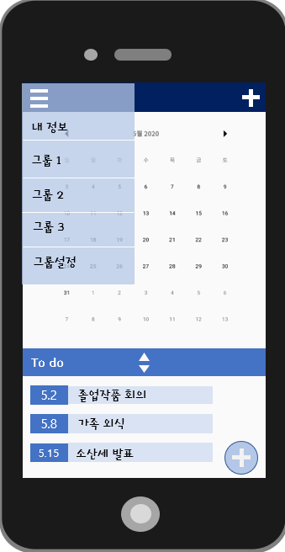
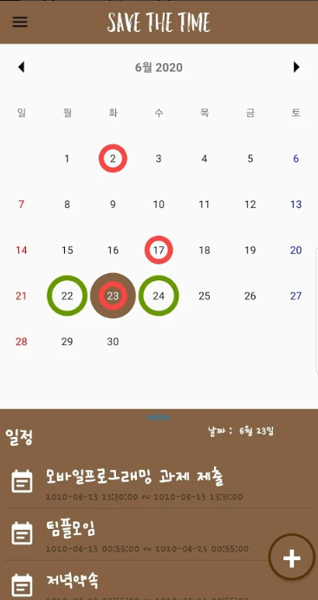
05. Implementation details
Main page
User can register the schedule
UI draft
Final implementation

Slide 9
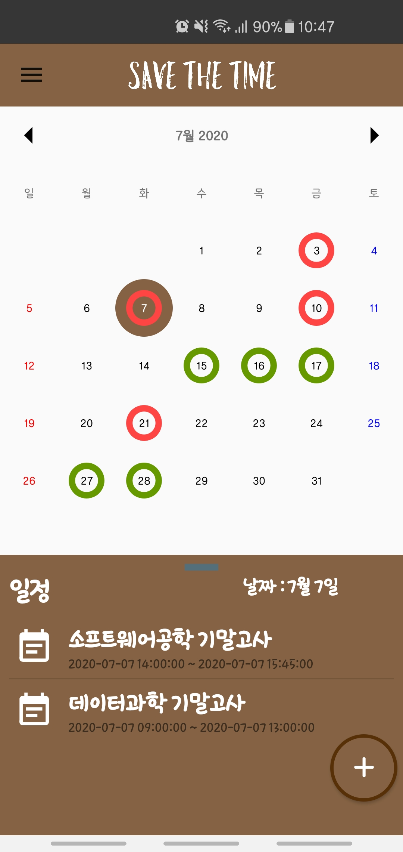
05. Implementation details
01
View your personal information and groups
When you click this button, a window made of drawer comes out from the side.
This window shows the user's information and subscribed groups.
Calendar function
The calendar shows individual schedules in red circles and group schedules in green circles.
View Selected Date Schedule
When the user clicks on a date, it shows the schedules stored on the selected date.
02
03

Slide 10
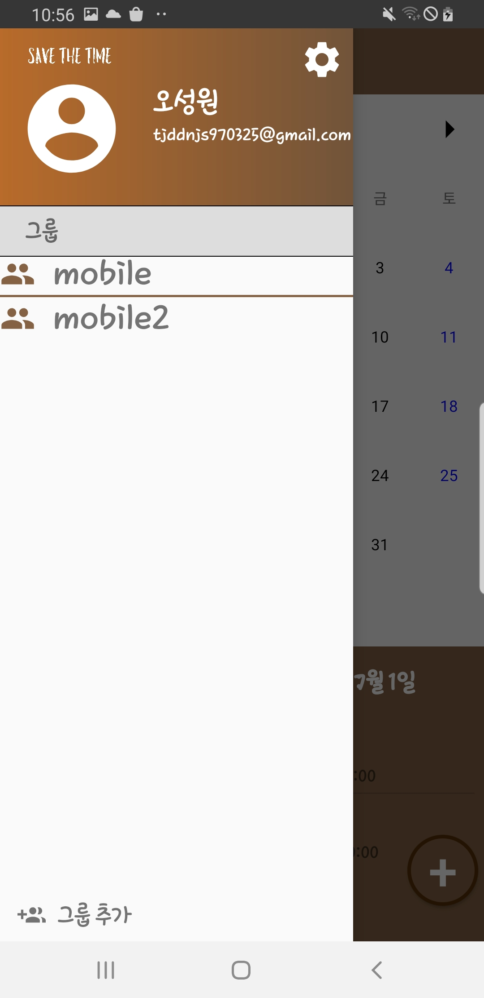
05. Implementation details
01
setting button
It has the function to delete the entire schedule, withdraw membership, and log out.
Individual Info
The email and name of the logged-in user are printed.
Joined Groups List
Clicking on each group will take you to the group information page.
Add Group Button
02
03
04

Slide 11
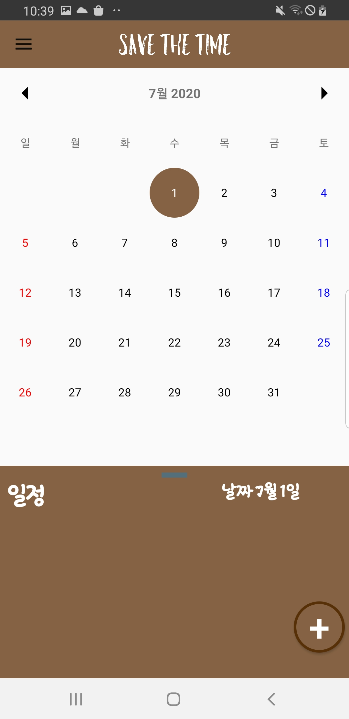
05. Implementation details
Schedule add function
If you want to register your schedule on the main screen, you must click the following +shaped button.
Click the Schedule add button

Slide 12
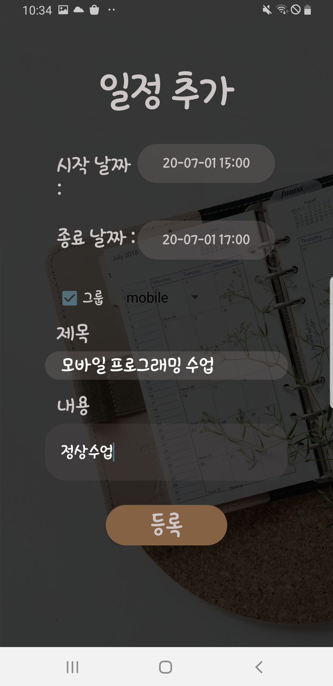
05. Implementation details
To set a schedule date & time
Set up a group to register the schedule to
If you want to register a group schedule, click the checklist and select the group to register.
Write down the title and contents
01
02
03

Slide 13
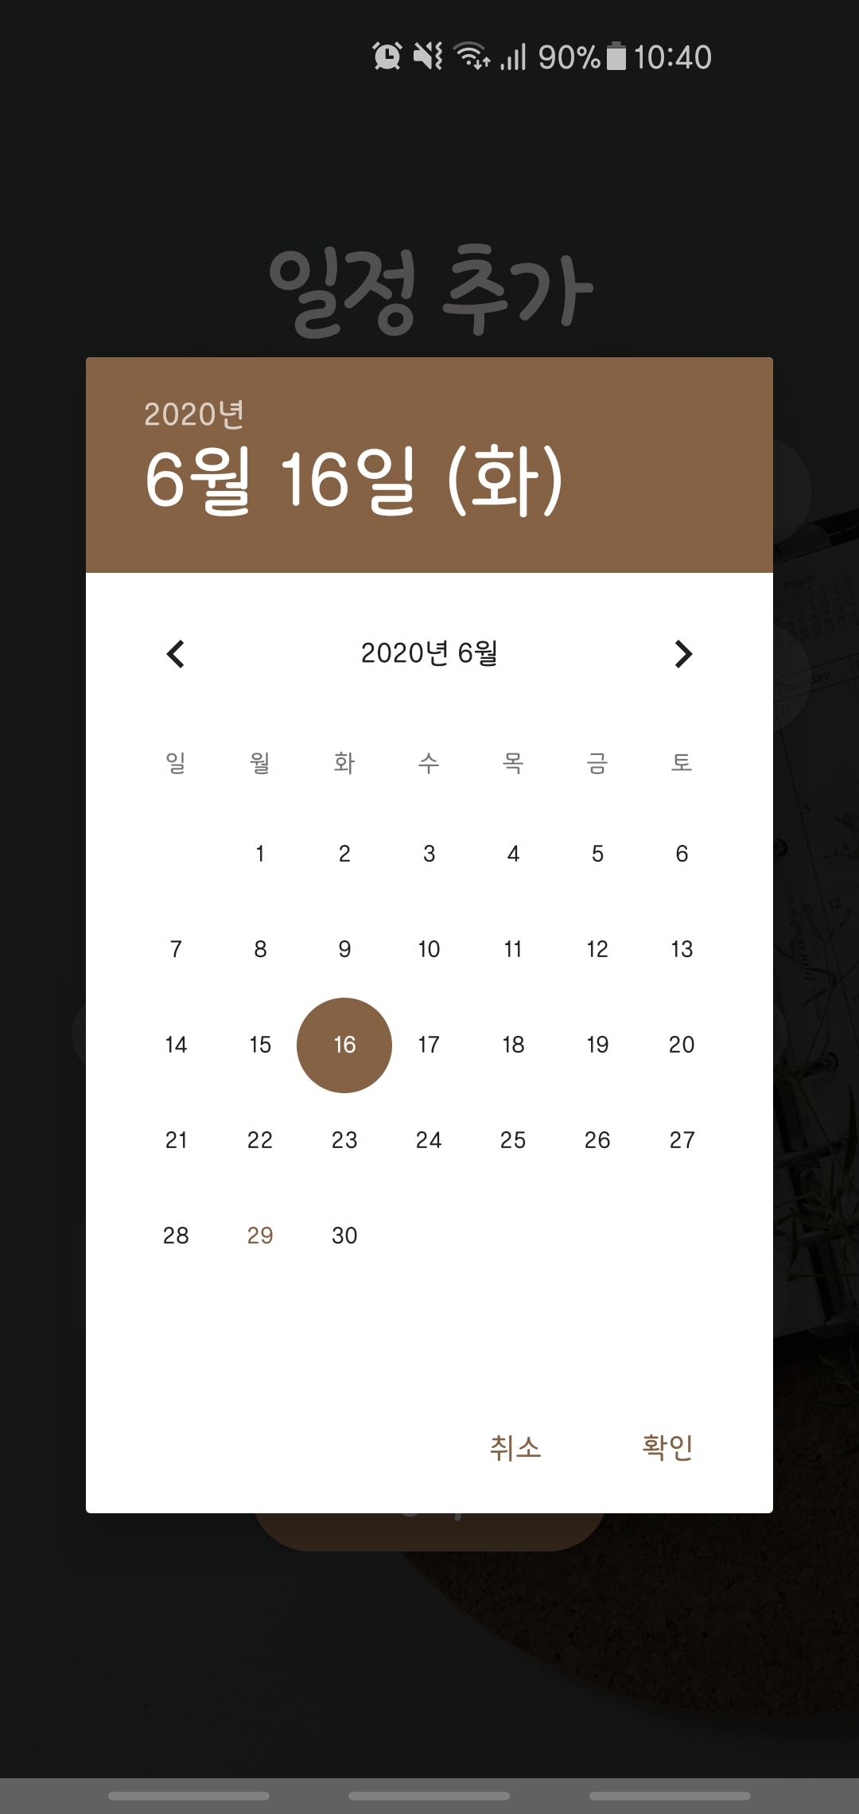
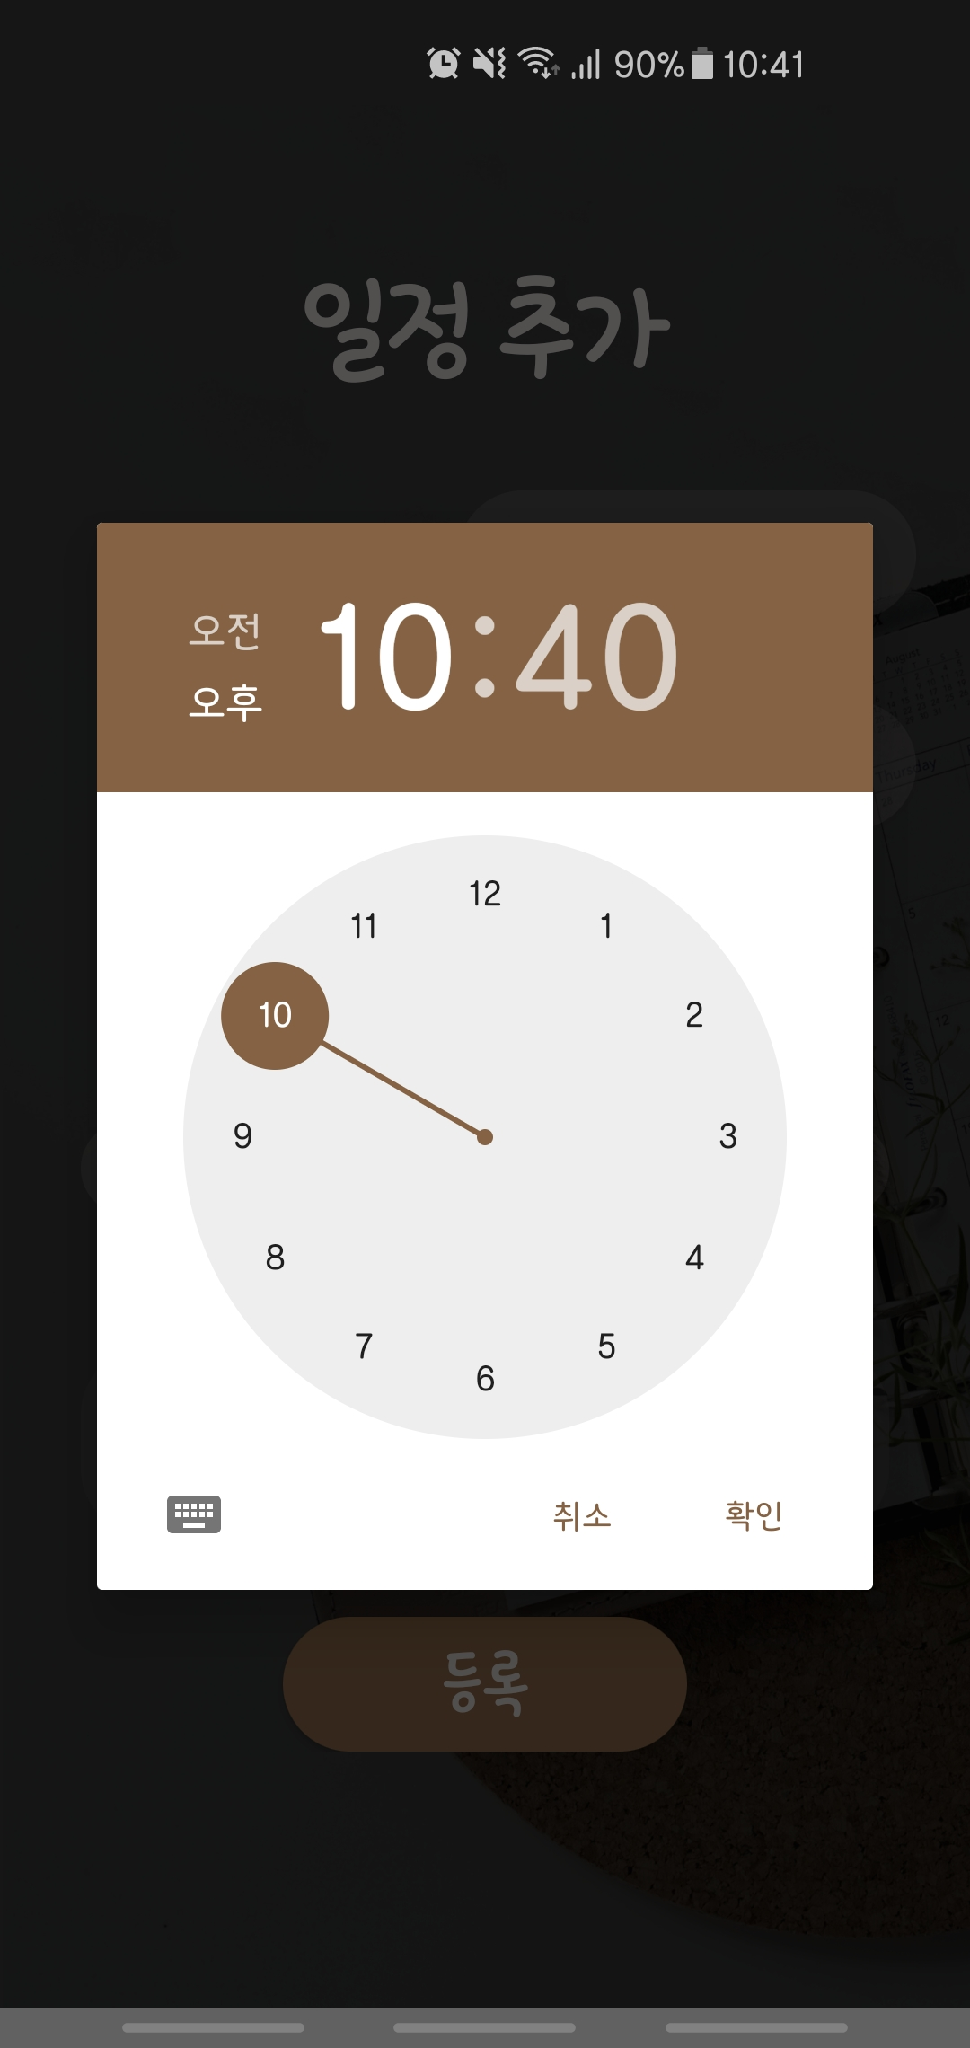
05. Implementation details
To set a schedule date & time
We Use Date Picker to make it easier to select the schedule and time to schedule.

Slide 14
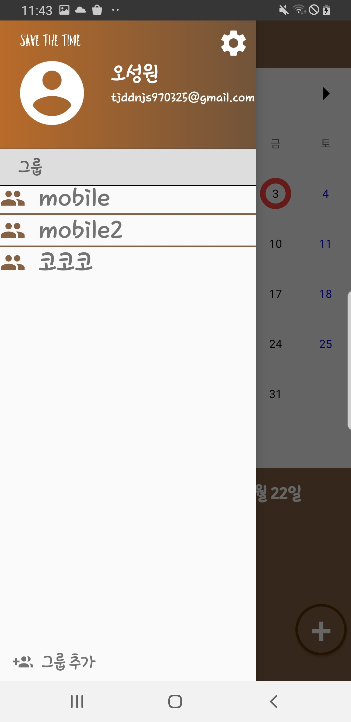
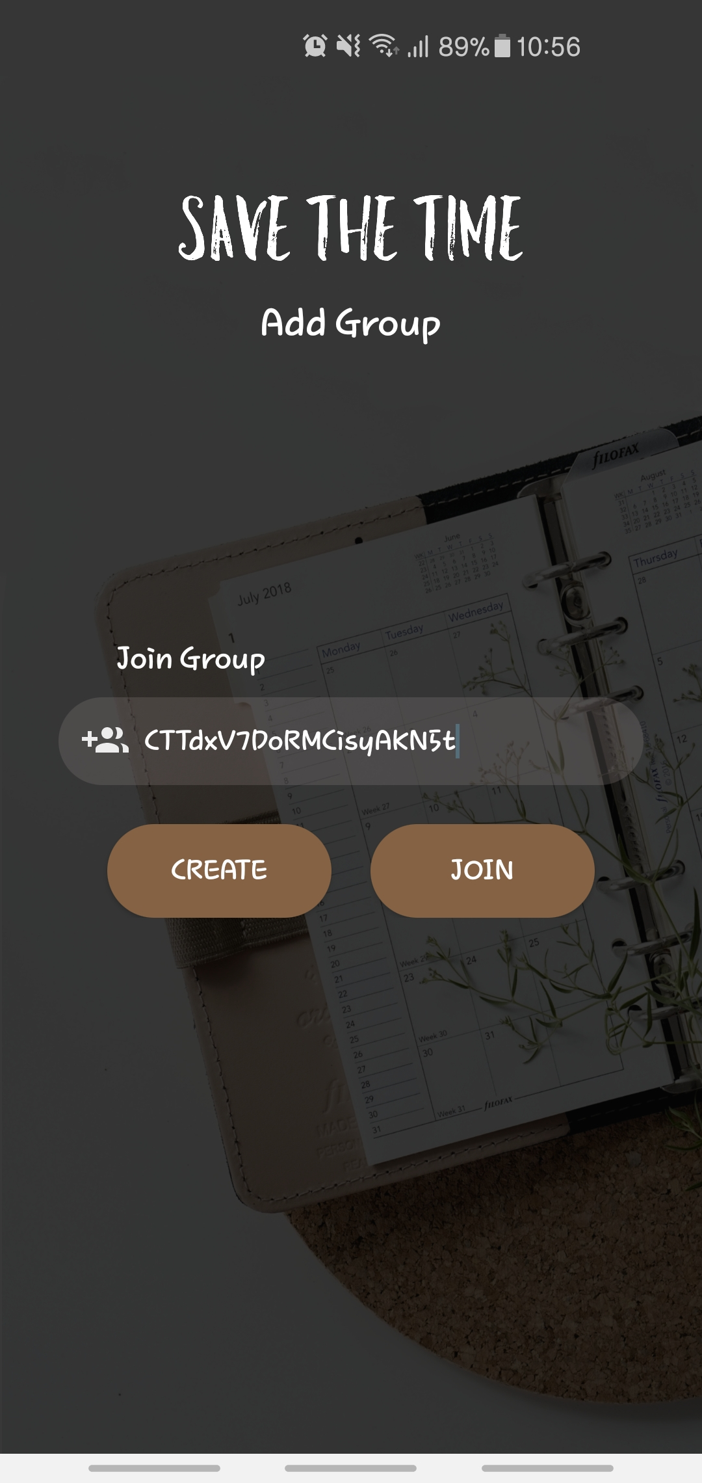
05. Implementation details
Add group function
Press the Add Group button to go to the page where you can join and create a group. Use this page to join a group.
Click

Slide 15
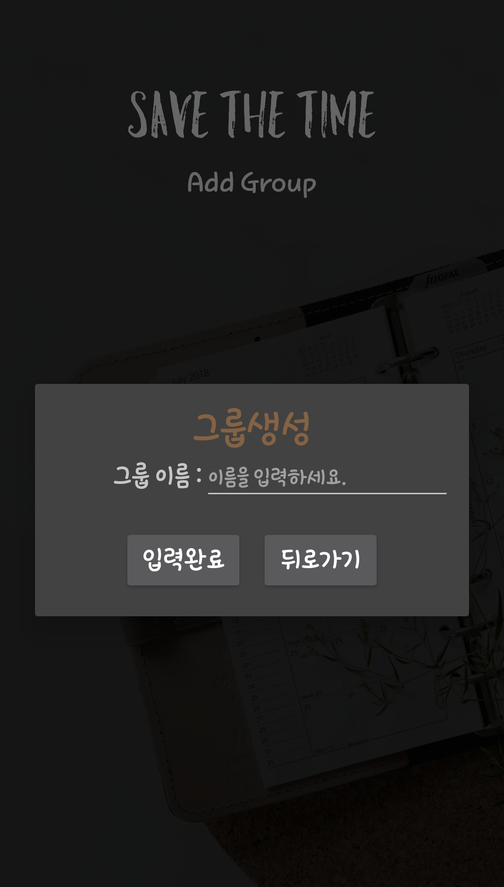
05. Implementation details
Join Group
you can join by receiving and entering the group's ID from another user.
2,3 Create new group
01
03
02
You can simply create a group by entering the name of the group.
Click the create button

Slide 16
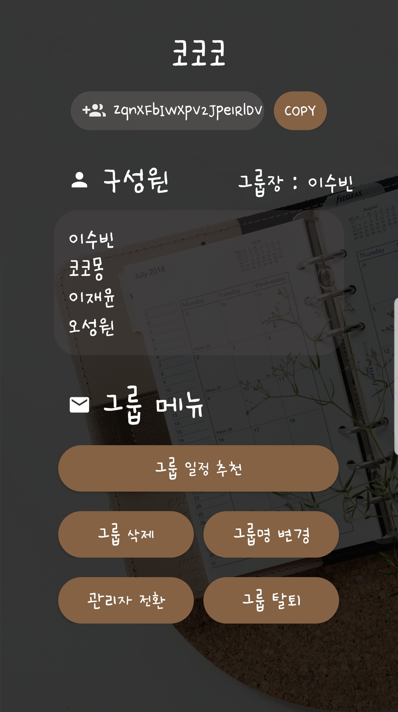
05. Implementation details
Group info/manage page
The Groups page allows you to view group information and manage the group.
Click the Group

Slide 17
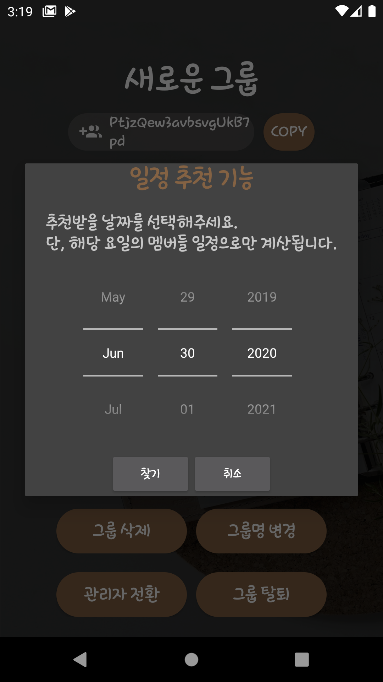
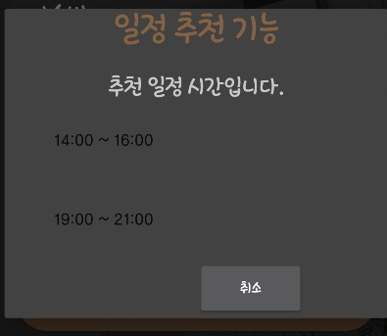
05. Implementation details
Schedule recommendation
The system analyzes the schedule of group members and recommends
time zones for meetings
Click the button

Slide 18
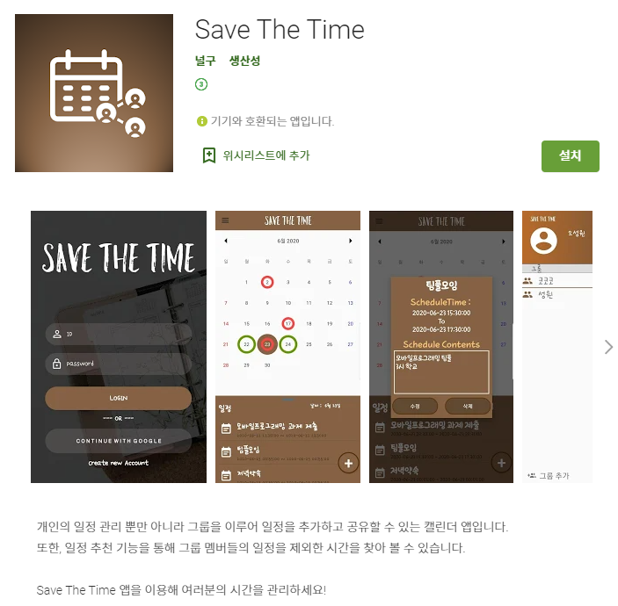
Play store
You can download right now !

Slide 19
Thank
You

